Slide 1

Directories
PRESENTED BY :
BHIM RAJ BHANDARAI
ROSHAN SAUD
MANJIL BAJGAIN

Slide 2





Introduction to Directories
Organizing Files
Hierarchical Structure
Table of Contents Analogy
Directories, also known as folders, are special files designed to organize and manage other files and subdirectories. They act as a crucial organizational layer within file systems.
They impose a hierarchical or tree-like structure on data, simplifying the location, access, and management of thousands or even millions of files. This structure is fundamental for system efficiency.
Consider a directory as a book's table of contents. It doesn't contain the actual content (files) but rather references (like page numbers) to their locations, enabling quick navigation.
This section will explore directory organization, properties, and common operations, providing a foundational understanding of file system management.

Slide 3
✅ What it means, in simple terms:
Every file or folder on your computer has metadata.
Metadata = “data about data” → like file name, size, date created, permissions, etc.
A directory (folder) doesn’t just store the list of files; it also keeps extra information (metadata) about each file/subfolder inside it.
When a directory has many subfolders or files, the operating system must keep track of all their metadata.
👉 This extra bookkeeping uses extra disk space and memory → that’s what “storage overhead” means.
✅ Example with numbers:
Imagine you have a folder with 1 million subfolders.
For each subfolder, the system must store things like:
Subfolder name (e.g., "Photos")
Creation date, modified date
Permissions (who can read/write)
Pointer to where the folder contents are stored
Let’s say each entry takes ~256 bytes of metadata.
1 million subfolders × 256 bytes = 256 MB just for metadata, before any files are stored!
So the more subdirectories you have, the more extra space (overhead) is needed just to manage them.
👉 So in simple words: If you create too many subfolders, the system has to keep a big “address book” of them. That address book itself takes up extra storage space, even if the folders are empty..

Slide 4
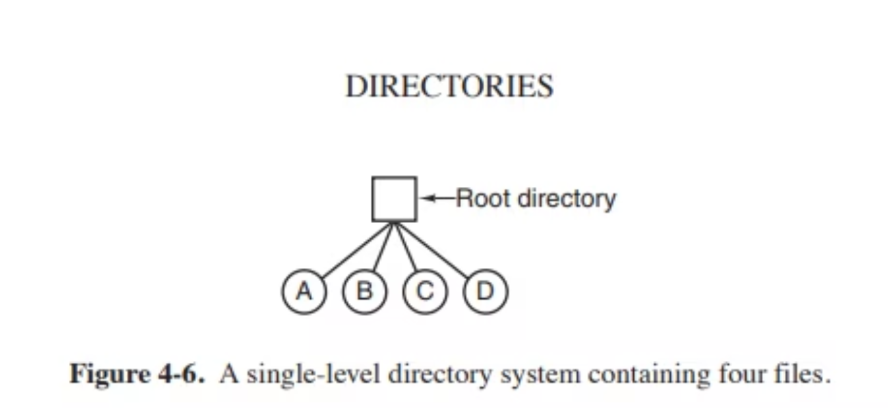


Single-Level Directory System
The Single-Level Directory System represents the most fundamental file organization method. All files reside in a single, undifferentiated directory, lacking any subdirectories.
Historically, this simple approach was common in early computing systems, including personal computers and supercomputers like the CDC 6600, prioritizing ease of implementation.
Advantages:
Extreme simplicity in use and management.
Rapid file searching due to centralized storage.
Disadvantages:
Prone to disorganization as file count increases.
Unsuitable for multi-user environments or large-scale systems.
Today, its use is limited to simple devices like digital cameras or MP3 players, where a minimal number of files are managed.

Slide 5
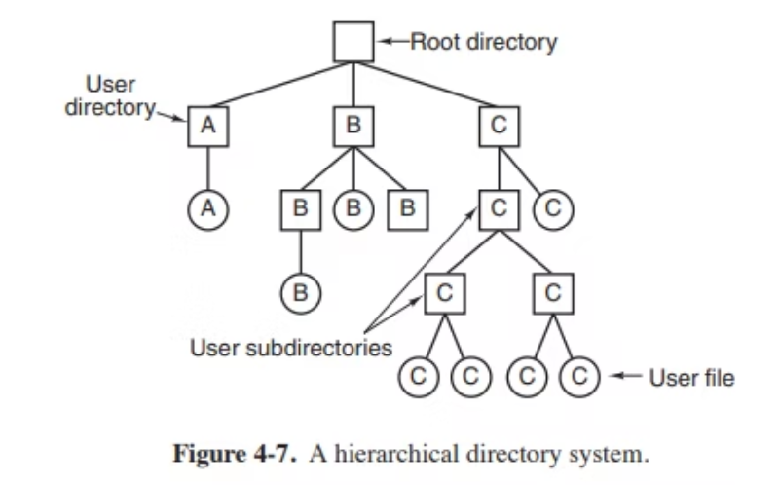
Hierarchical Directory Systems
Hierarchical Directory Systems organize files into a tree-like structure, allowing users to group related files into distinct folders (directories) and create nested subfolders(4,294,967,295 (2³² − 1)).
This system effectively resolves the "clutter" issue prevalent in single-level systems by enabling multiple levels of organization.
Advantages:
Facilitates efficient organization and management of vast file quantities.
Robust support for multi-user environments, each with dedicated directories.
Disadvantages:
File paths can become excessively long and challenging to recall.
Requires increased storage overhead for directory metadata management.

Slide 6





Path Names and Directory Operations in File Systems
CreateFiles/Folders
MoveFiles/Folders
NavigateDirectories
DeleteItems
Grasping the mechanism of path names and directory management is crucial for effective interaction with file systems, enabling precise control over data organization and accessibility.

Slide 7
Path Names: Absolute vs. Relative
Absolute Path Names
Relative Path Names
Start from the root directory, providing a complete and unique address for any file or directory within the file system.
Defined in relation to the current working directory, offering a shorter and more convenient way to specify locations.
Always begin with the directory separator (e.g., / in UNIX, \ in Windows).
Do not start with the directory separator.
Depend on the user's current location within the directory tree.
Guaranteed to work, regardless of the current working directory, crucial for system-level programs.
Special entries: . (current directory) and .. (parent directory).
Examples:
Example: If working in /usr/ast, mailbox refers to /usr/ast/mailbox.
/usr/ast/mailbox
\usr\ast\mailbox
Understanding these two path types is fundamental for efficient file system navigation and management.

Slide 8
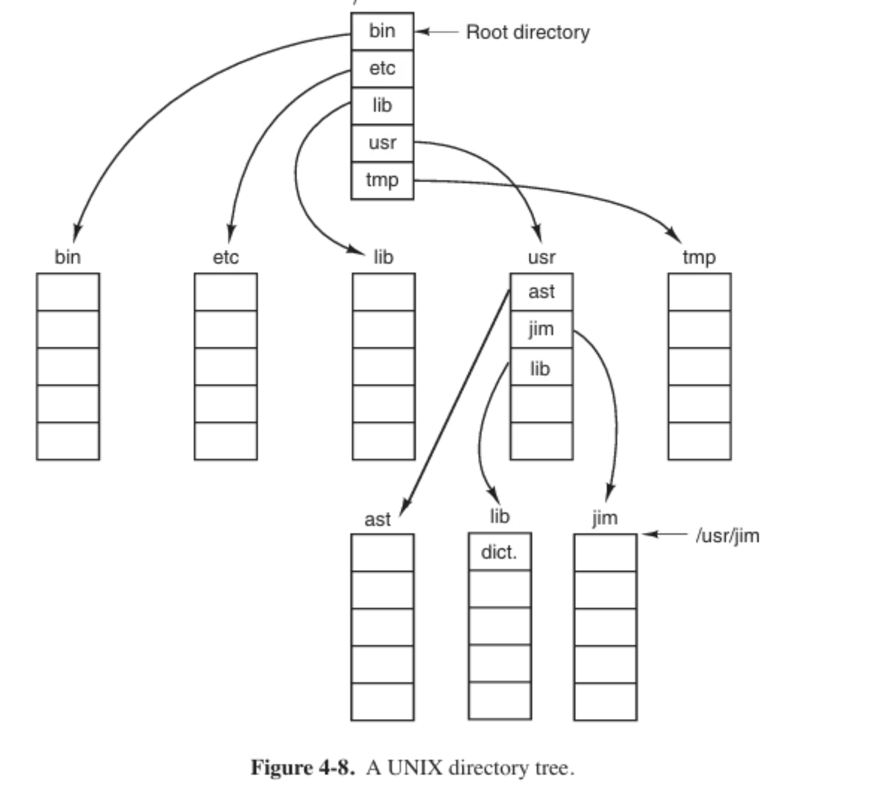

Slide 9






Directory Operations
File systems provide a set of essential operations to manage directories effectively, enabling users and applications to create, organize, and manipulate the hierarchical structure of files.
Create
Delete
Establishes a new directory, automatically populated with . (current) and .. (parent) entries.
Removes an existing directory, but only if it is empty (contains only . and ..).
Rename
Link
Changes the name of a directory, similar to renaming a regular file.
Creates a reference to a file in another directory. This includes both hard links and symbolic links.
Unlink
Read Directory
Removes a directory entry. If it's the last reference to a file, the file is deleted from the system.
Allows programs to open, read entries (readdir), and close directories (closedir) to list their contents.
These fundamental operations, while varying slightly between systems, form the backbone of file system interaction and organization.

Slide 10

File System Implementation
When studying file systems, it's important to look at it from two distinct perspectives:
👤 User’s View
🛠️ Implementor’s View
Users primarily focus on how they interact with the file system:
System designers and developers are concerned with the underlying mechanisms:
How files are named and organized logically.
What actions they can perform (read, write, delete, copy, etc.).
How files and directories are physically stored on the disk.
Efficient management of disk space.
How directories appear and how to navigate them (directory tree, paths).
Ensuring optimal speed, reliability, and security of data.
This perspective centers on technical implementation and performance.
This perspective emphasizes usability and the user interface.
Understanding both views is essential for comprehensive file system design and interaction.

Slide 11
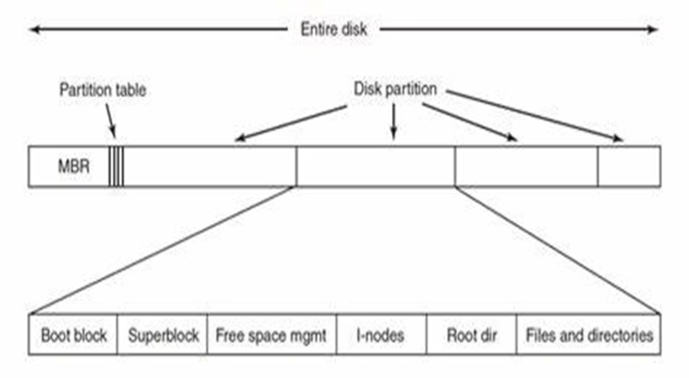
File System Layout on a Disk
From an implementor's perspective, the physical organization of a file system on a disk dictates how data is fundamentally stored, managed, and retrieved. This structured layout ensures efficient operation and data integrity.
A typical disk partition designated for a file system is logically divided into several critical sections:
Boot Block
Super Block
The very first sector, containing the bootstrap loader program necessary to initialize the operating system.
Holds vital metadata about the entire file system, including its state, size, the number of inodes, and the location of the free block list.
Inode Block
Data Blocks
An array of inode entries. Each inode stores detailed information about a single file or directory, such as permissions, ownership, timestamps, and pointers to its data blocks.
The largest section, where the actual content of files and directories is stored. These blocks are allocated as needed by the file system.
This organized layout is fundamental to the efficient and reliable operation of any modern file system.

Slide 12
Step-by-Step: File System Layout on Disk
Understanding how a file system is organized on a disk is crucial for grasping its foundational operations. This structured layout ensures efficient data management and retrieval.
Step 1: Disk and Partitioning
Step 2: Master Boot Record (MBR)
A physical disk can be logically divided into several partitions, each capable of containing an independent file system. The very first part of the disk is reserved for the Master Boot Record (MBR).
Step 3: Boot Block
Every partition begins with a Boot Block. For bootable partitions, it contains a program to load the operating system. Even non-bootable partitions include a boot block for future compatibility or diagnostic purposes.
Positioned in the disk's first sector, the MBR houses a small program for initial boot-up and a Partition Table. This table defines the start and end addresses of each partition, marking one as active for booting.
During system startup, the BIOS executes the MBR, which then locates and runs the active partition's boot block.
This fundamental layering, from the entire disk down to the specific boot and data blocks, underpins the robust design of modern file systems.

Slide 13
Step-by-Step: File System Layout on Disk (Cont.)
Continuing our exploration of the physical organization, these next layers are crucial for managing file system metadata and the actual file content.
Step 5: Free Space Management
Step 4: Superblock
This section is dedicated to managing the disk's available and allocated blocks. It keeps track of which blocks are free and which are in use, enabling efficient allocation and deallocation of space as files are created and deleted.
Immediately following the Boot Block, the Superblock contains critical metadata about the entire file system, including its type, total number of blocks, and other administrative data. It's loaded into memory during boot for quick access.
Role of Inodes
Step 6: Inodes (Index Nodes)
Inodes are fundamental data structures in Unix-based file systems, created during initialization. Each file or directory has a unique inode, which identifies and manages its metadata (permissions, ownership, timestamps, and pointers to data blocks), excluding only the file name itself.
Identifies and manages file metadata
Stores everything except the file name
Limits the maximum number of files/directories in a file system
These foundational elements work in concert to ensure the integrity, accessibility, and efficient management of all data stored on the disk.

Slide 14
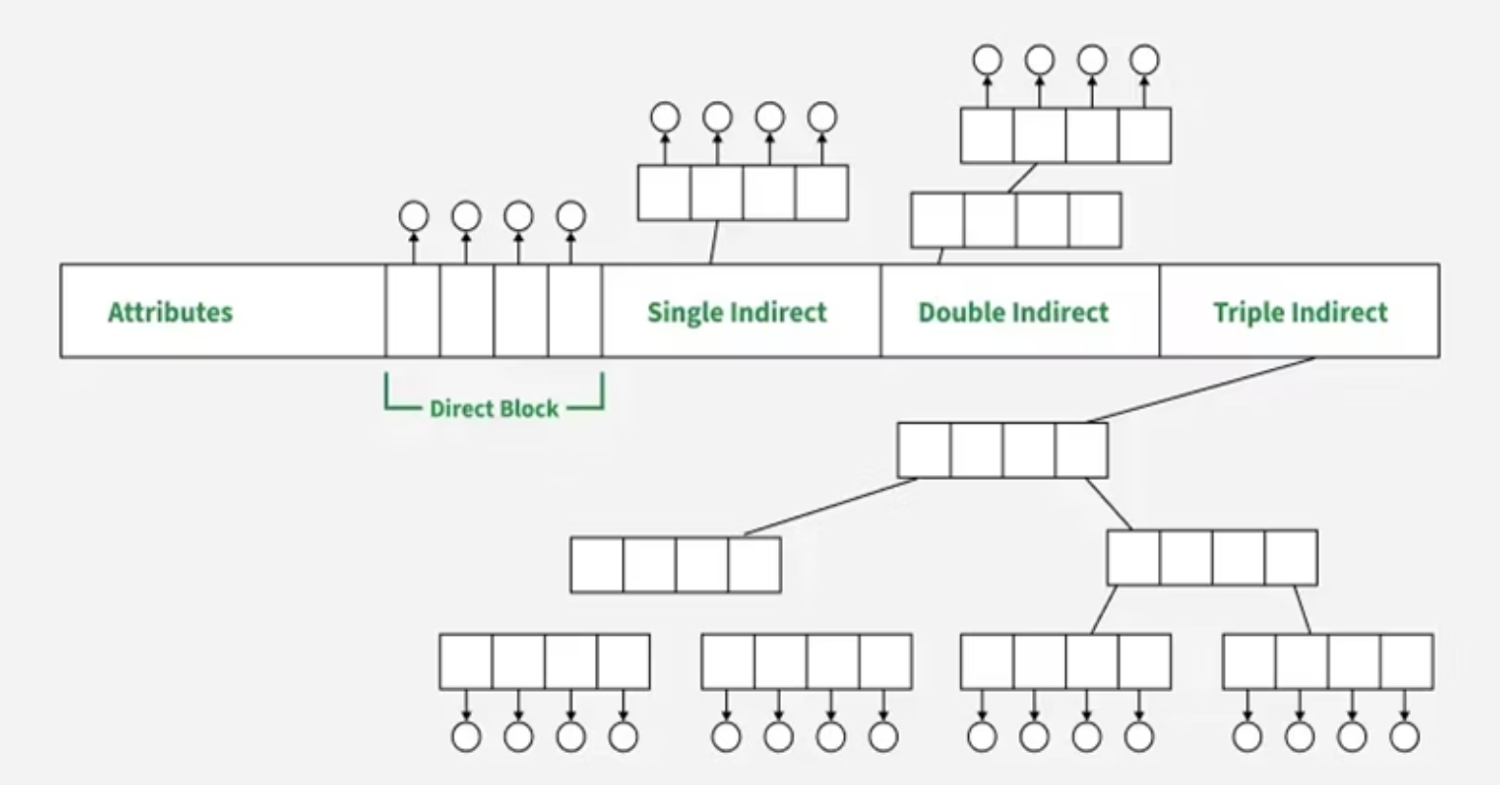
What’s Inside an Inode?
An inode is a fundamental data structure in Unix-like file systems, storing crucial metadata about a file or directory. It acts as a descriptor, providing all necessary information about the file itself, except for its name and the actual data content.
Key Attributes:
✅ Ownership (UID & GID): Identifies the user and group that own the file, controlling access.
✅ File Size: The total size of the file in bytes.
✅ File Type: Specifies if it's a regular file, directory, symbolic link, block device, character device, etc.
✅ Permissions: Defines who can read, write, or execute the file (e.g., owner, group, others).
✅ Time Stamps: Records creation, last modification, and last access times.
Fig: Inode Block Structure
Pointers to Data Blocks:
This is where an inode truly shines. Instead of storing data directly, it contains pointers (addresses) to the actual data blocks on the disk.
Direct Blocks: Directly point to data blocks containing the file's content, used for smaller files.
Single Indirect Block: Points to a block that, in turn, contains pointers to data blocks.
Double Indirect Block: Points to a block that contains pointers to single indirect blocks.
Triple Indirect Block: Points to a block that contains pointers to double indirect blocks, allowing for very large files.
The file system dynamically uses these different types of data block pointers depending on the file's size, optimizing storage and access efficiency.

Slide 15
Inode Block Structure: Data Pointers
To efficiently manage files of varying sizes, file systems utilize a sophisticated structure of data block pointers within each inode. This hierarchical approach allows for flexible and optimized storage of file content.
1
2
Direct Blocks
Single Indirect Block
These pointers directly reference data blocks on the disk, storing the initial content of smaller files. Most inodes contain a fixed number of direct pointers (e.g., 12).
For larger files, if direct blocks are exhausted, this pointer points to a special block that, in turn, contains addresses (pointers) to additional data blocks.
3
4
Double Indirect Block
Triple Indirect Block
When a file grows even larger, this pointer points to a block which contains pointers to single indirect blocks, further extending the file's capacity.
For extremely large files, this pointer references a block that contains pointers to double indirect blocks, enabling access to a vast number of data blocks.
The file system dynamically determines which type of data block pointers to use based on the file's current size, ensuring efficient storage allocation and retrieval across all file sizes.

Slide 16
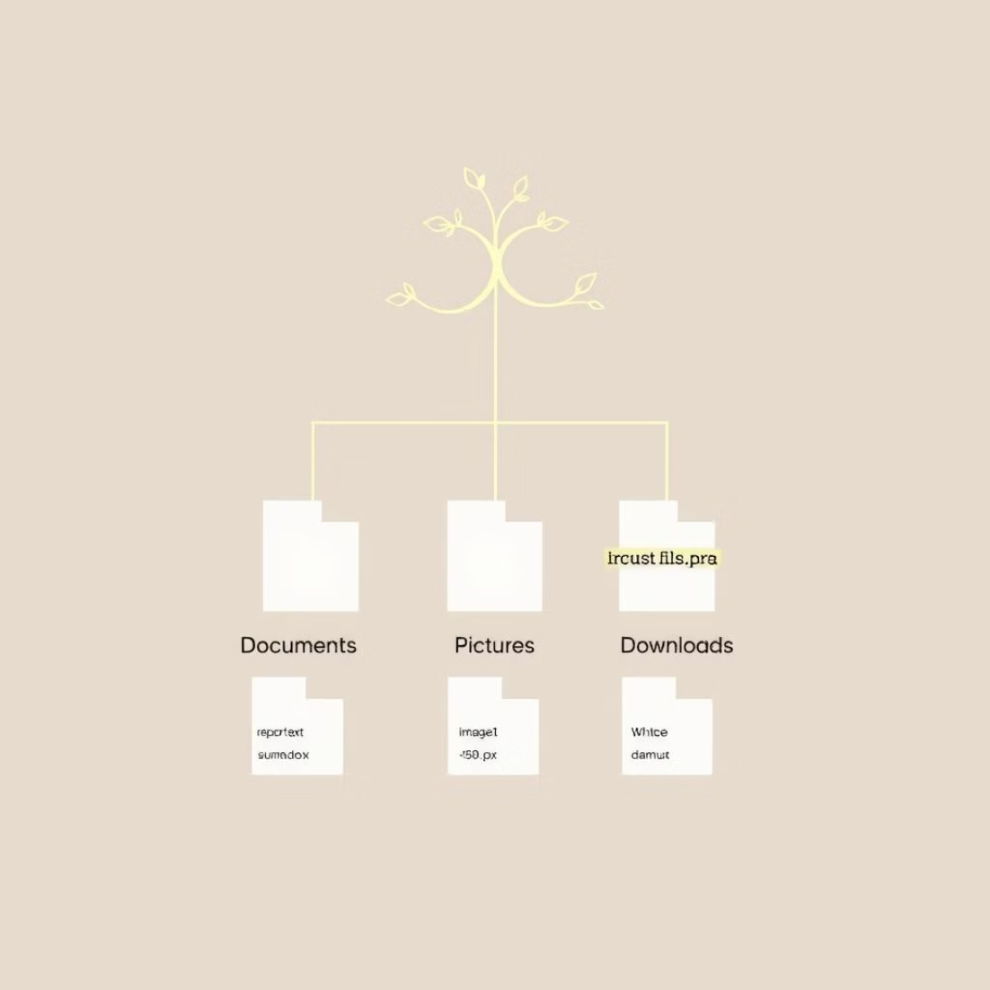
File System Layout: Data Allocation & Hierarchy
As we delve deeper into file system organization, understanding how data blocks are allocated based on file size, and the establishment of the root directory and subsequent file hierarchy, are crucial steps.
Data Block Allocation by File Size
Continuing the Layout Sequence:
Inodes use various pointer schemes to efficiently manage files of different sizes:
Step 7: Root Directory
Small File
Direct Blocks only
The Root Directory (/) is the top-level directory in the file system hierarchy. It serves as the starting point for all file paths and is directly referenced by the file system upon initialization.
Medium File
Direct + Single Indirect
Large File
Direct + Double Indirect
Step 8: Files and Directories
Very Large File
Direct + Triple Indirect
The remaining part of the partition contains all other directories and files. These are organized hierarchically under the root directory, forming the familiar tree structure of the file system.
This comprehensive structure ensures robust storage and efficient navigation within the file system.

